Slide 1
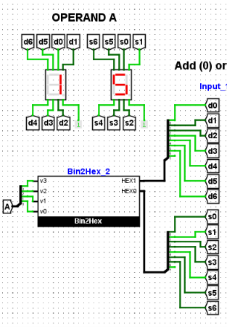

7 Segment Display

Slide 2
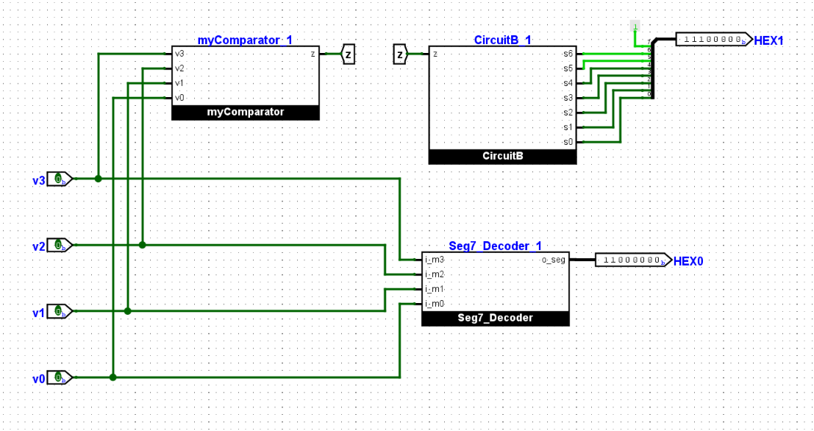
Bin2Hex

Slide 3
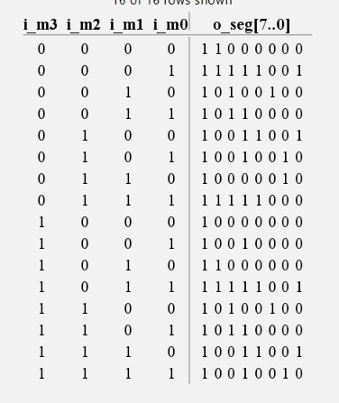
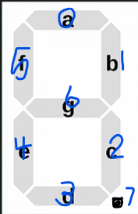
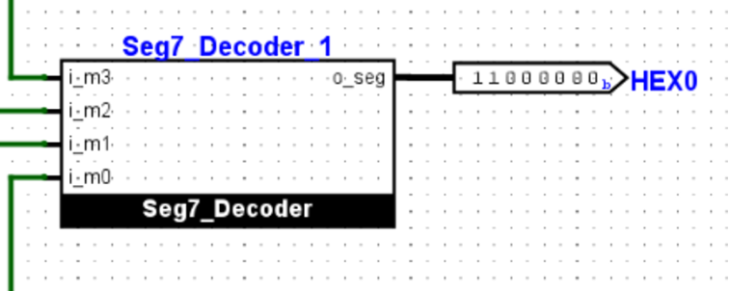
Bin2Hex → Seg7_Decoder
HEX0 leads to the 7-segment display
Labeled below which bit controls which segment

Slide 4
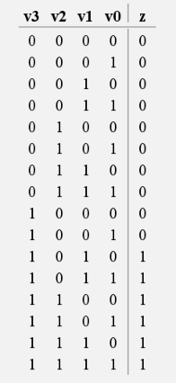
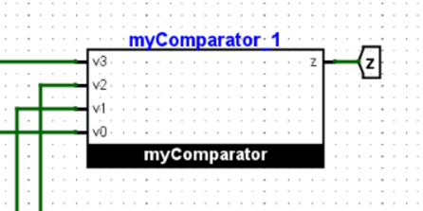
Bin2Hex → myComparator
mycomparator takes a BCD value. If value corresponds with a decimal number >9 then z=1. otherwise z=0

Slide 5
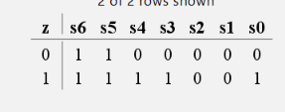
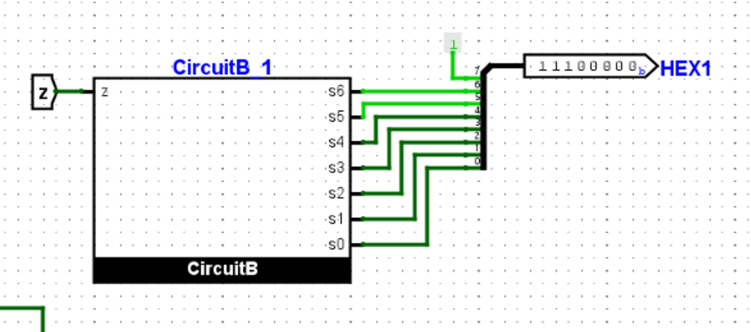
Bin2Hex → CircuitB
HEX1 is connected to the 10’s place 7-segment display. Picture shows which bit controls each segment
CircuitB takes the value of z, and sets the bits controlling the 7 segment display to 0’s & 1’s accordingly

Slide 6
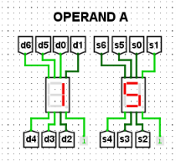
Check

